Slide 1
Power Electronics for Arduino
Pierce Nichols
28 March 2015

Slide 2
Motivation
Arduino pins can only source or sink 40 mA @ 5V
That’s unusually high for a microcontroller… most are less
Many interesting loads need higher current and voltage
High power LEDs
Relays
Solenoids
DC Motors
Stepper Motors

Slide 3
Stuff to Download
Download & install Arduino 1.6.1 installer from http://arduino.cc/en/Main/Software
Go to the Github repository, https://github.com/logos-electromechanical/PowerElectronicsForArduino and either clone or download the zip ball.

Slide 4
Topics for Today
Bipolar Transistors
Basic Construction & Properties
Common Emitter/Open Collector
Driving and LED
Inductors
MOSFETs
N-channel & P-channel
Driving an LED
Buck Diodes
Driving a Motor
H-Bridge
L293 integrated H-bridge
Discrete H-bridge
Motor control
A few other things to know

Slide 5
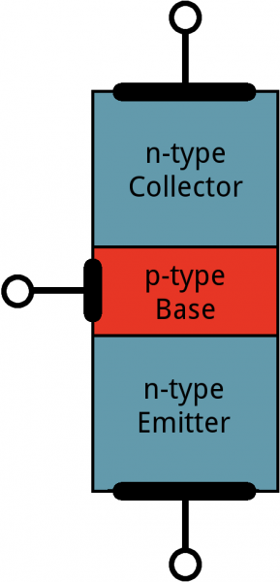
Bipolar Junction Transistors (BJTs)
Acts as a sort of valve for electrical current
Built by stacking 3 types of semiconductor together.
The three terminals are the collector (electrons in), base (control), and emitter (electrons out).
Quantum mechanical handwaving allows a small current at the base to control a large current from collector to emitter.
We’ll focus on NPN type here; PNP just reverses all the signs and directions.

Slide 6
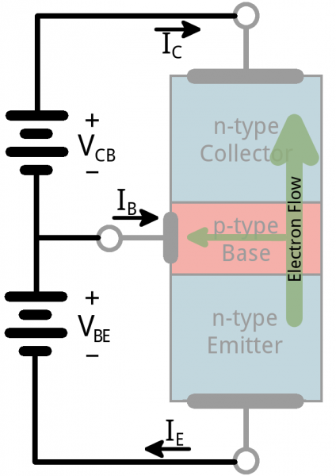
Current Flow in a BJT
Current flows from base to emitter and from collector to emitter.
Four modes of current flow:
Saturation – transistor acts like a diode from collector to emitter.
Cut-off – transistor acts like an open switch.
Active – the collector-emitter current is proportional to the base-emitter current.
Reverse-active – Like active, but in reverse, and much lower gain.

Slide 7
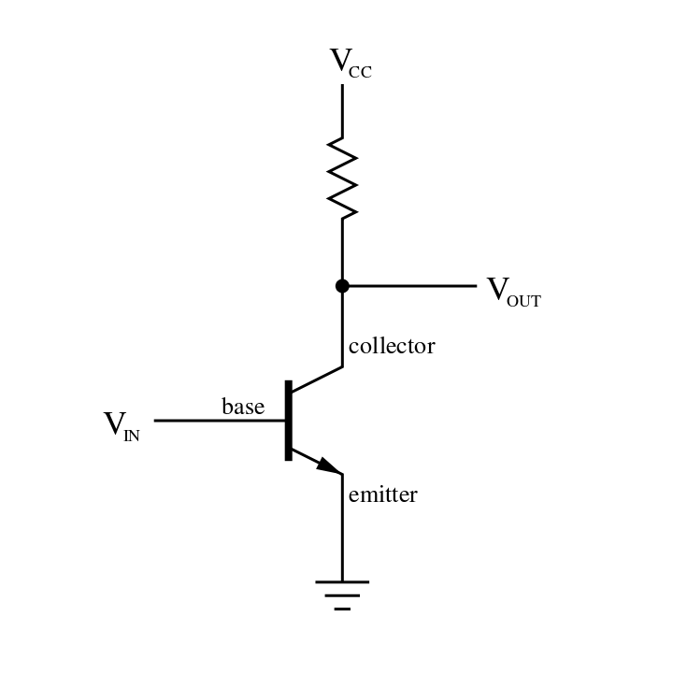
BJT Operation Modes
Saturation
V_{E} < V_{B}
V_{C} < V_{B}
Cut-off
V_{E} > V_{B}
V_{C} > V_{B}
Forward Active
V_{C} > V_{B} > V_{E}
Reverse Active
V_{C} < V_{B} < V_{E}

Slide 8
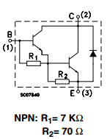
The TIP120
This is a common NPN power transistor
It’s a Darlington pair, which increases the current gain (minimum 1000 for the TIP-120)
Max collector-emitter voltage 60V
Max collector current 5A
Vce(sat) = 2V

Slide 9
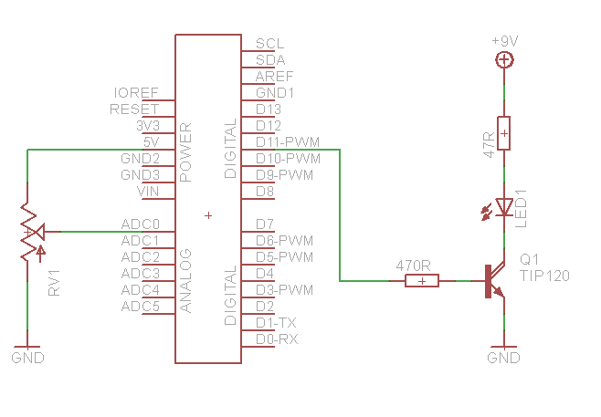
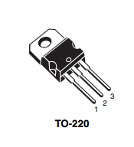
TIP120 Demo Circuit
Load AnalogLEDControl sketch
Wire as shown

Slide 10
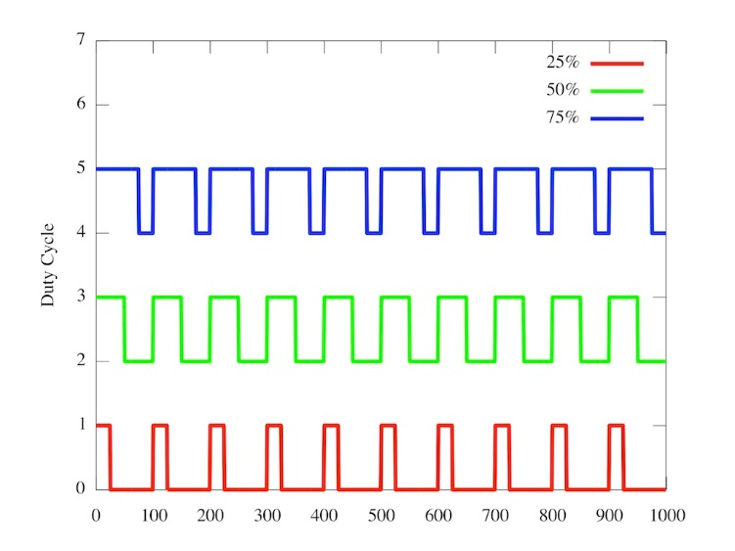
Pulse Width Modulation

Slide 11
MOSFETs (Metal Oxide Semiconductor Field Effect Transistors)
Come in N-channel and P-channel
Roughly equivalent to NPN and PNP
N-channel usually goes between load and ground (low-side)
P-channel usually goes between power and load (high-side)
Voltage mode devices
Turn enhancement-mode devices on by charging the gate capacitor
Act like a resistor regulated by the gate voltage
Minimum resistance can be VERY low… sub 5 milliohm devices are on the market.
Therefore, the power loss through a MOSFET is typically lower than a BJT

Slide 12
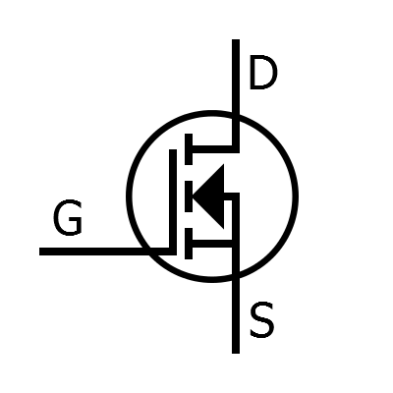
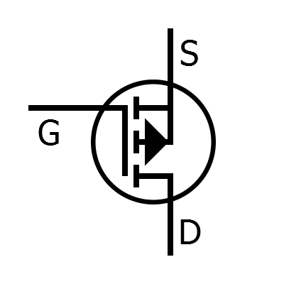
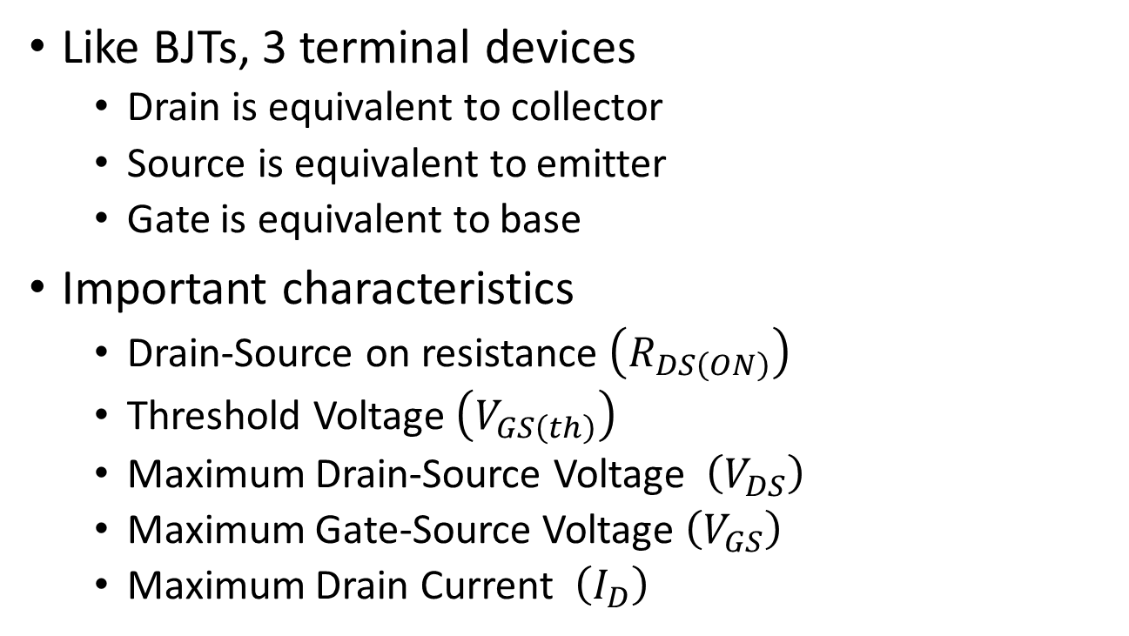
MOSFETs continued
Like BJTs, 3 terminal devices
Drain is equivalent to collector
Source is equivalent to emitter
Gate is equivalent to base
Important characteristics
Drain-Source on resistance $\left(R_{DS\left(ON\right)}\right)$
Threshold Voltage $\left(V_{GS\left(th\right)}\right)$
Maximum Drain-Source Voltage $\left(V_{DS}\right)$
Maximum Gate-Source Voltage $\left(V_{GS}\right)$
Maximum Drain Current $\left(I_{D}\right)$
N-channel MOSFET (enhancement)
P-channel MOSFET (enhancement)

Slide 13
MOSFET advantages
Lower power loss than equivalent BJTs for lower voltage applications.
Smaller devices, smaller heat sinks, less power.
Positive temperature coefficient (i.e. current flow falls with increasing temperature)
This makes paralleling MOSFETs easier
Less drive power required

Slide 14
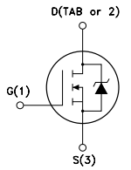
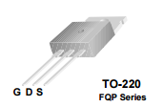
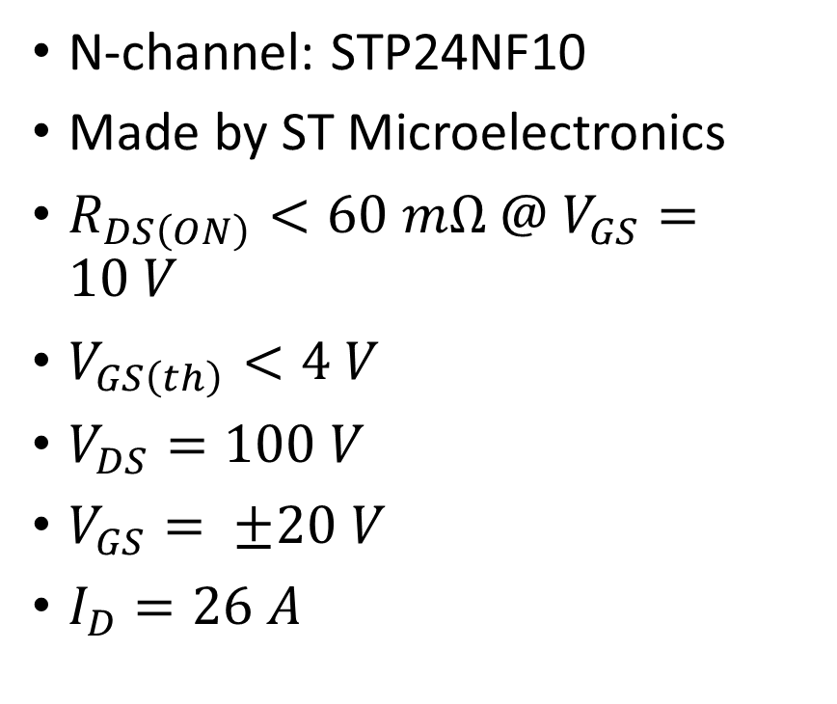
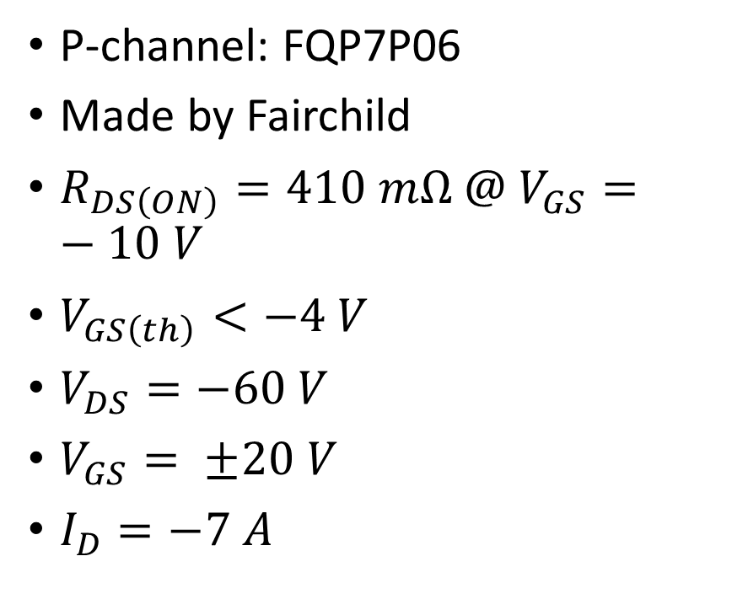
Our MOSFETs
N-channel: STP24NF10
Made by ST Microelectronics
$R_{DS\left(ON\right)}<60 mΩ @ V_{GS}=10 V$
$V_{GS\left(th\right)}<4 V$
$V_{DS}=100 V$
$V_{GS}= ±20 V$
$I_{D}=26 A$
P-channel: FQP7P06
Made by Fairchild
$R_{DS\left(ON\right)}=410 mΩ @ V_{GS}=−10 V$
$V_{GS\left(th\right)}<−4 V$
$V_{DS}=−60 V$
$V_{GS}= ±20 V$
$I_{D}=−7 A$

Slide 15
Considerations for Driving MOSFET Gates
The threshold voltage is the point at which the MOSFET just starts to conduct – to really turn it on, we want at least twice that.
MOSFET gates are tiny capacitors, so current rushes in when you turn it on. We need a series resistor on the gate to avoid damage.
The faster we switch the MOSFET, the more important it is that we switch it FAST – time spent in the linear region just dissipates heat.
MOSFET gate drivers capable of supply more than an amp of current are common.
Not really an issue at the speed of the Arduino PWM (490 or 980 Hz)

Slide 16
Driving our MOSFET gates
The threshold voltage of our N-channel MOSFETs is up to 4 V
Turning on our P-channel MOSFET requires us to pull the gate 4 V below the supply voltage.
But we’d like to power things off of 9 V…
We can use an open-drain inverting buffer to solve both problems.
When the input is high, the output is pulled to ground.
When the input is low, the output is left to float
We’re using the 74HC05, which has five open-drain inverting buffers.

Slide 17
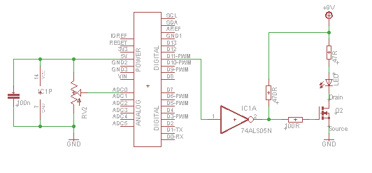
N-channel MOSFET LED wiring

Slide 18
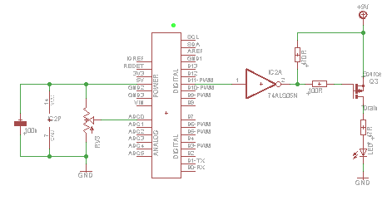
P-channel MOSFET LED wiring

Slide 19
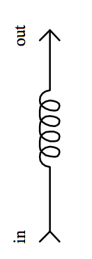
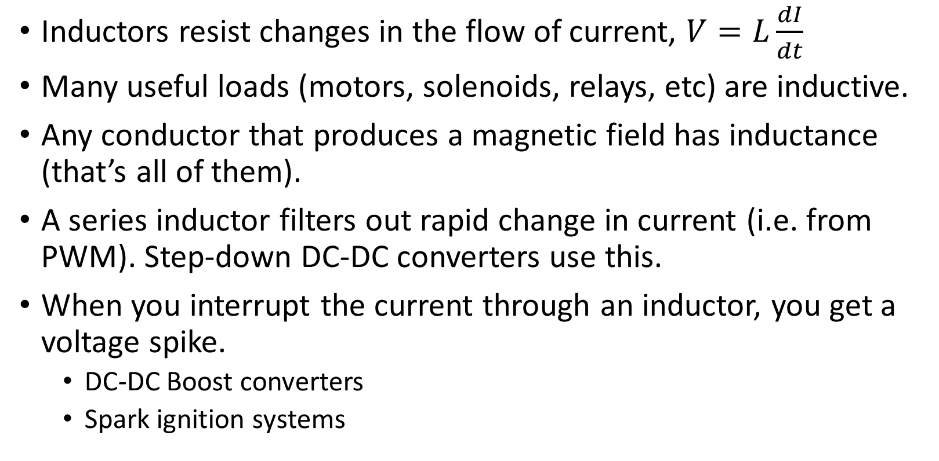
Inductors
Inductors resist changes in the flow of current, $V=L\frac{dI}{dt}$
Many useful loads (motors, solenoids, relays, etc) are inductive.
Any conductor that produces a magnetic field has inductance (that’s all of them).
A series inductor filters out rapid change in current (i.e. from PWM). Step-down DC-DC converters use this.
When you interrupt the current through an inductor, you get a voltage spike.
DC-DC Boost converters
Spark ignition systems

Slide 20
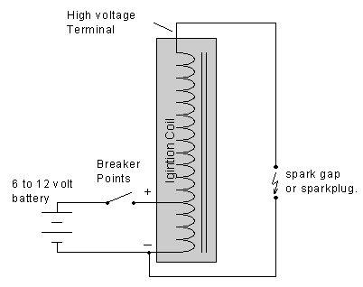
Spark ignition coil
Every gasoline engine’s ignition system works like this…
Old cars had a mechanical switch system called points and a distributor for the high voltage from a single coil
Modern cars have a coil with integrated electronics directly attached to each plug.

Slide 21
PWM and Inductive Loads
Our method of level control so far has been turning things on and off really fast…
With an inductive load we can expect this to produce big voltage spikes… (aka inductive kick)
So what can we do about those spikes?

Slide 22
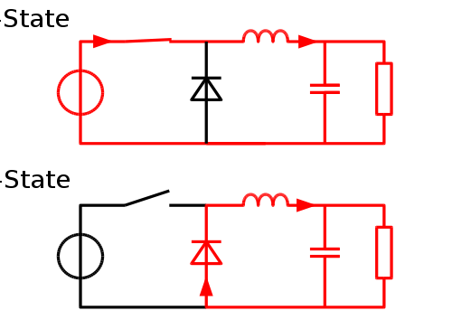
Protection, Buck, or Catch diodes
All names for essentially the same technique
These are diodes added in parallel with the inductor such that it provides an alternate current path when the switch is opened.
Schottky diodes are frequently used for this, because their forward voltage drop is very low.
Power MOSFETs often have a reverse diode built-in.

Slide 23
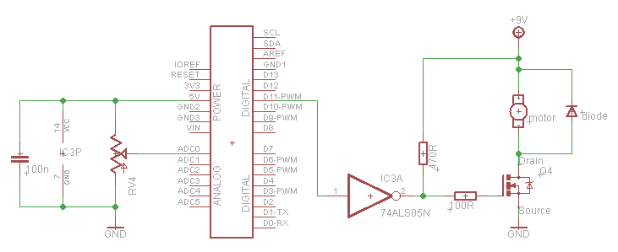
Simple Motor Driver Wiring

Slide 24
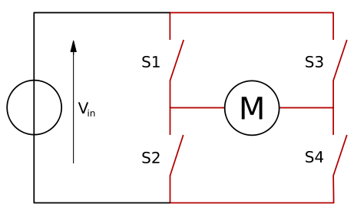
H-bridge
The previous arrangement has a serious downside – no directional control and no brakes.
We can solve both with an H-bridge…
Closing S1 & S4 or S2 & S3 turns the motor
Closing S2 & S4 applies the brakes

Slide 25
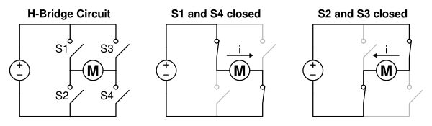
H-bridge current flow

Slide 26
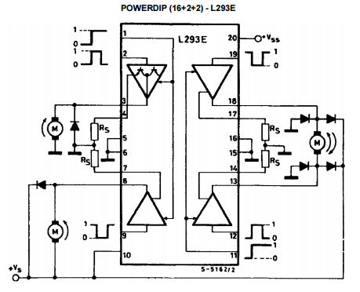
Integrated H-bridge (L293E)
We have four half-bridges integrated into a single package.
We’re not going to use the current sense resistors

Slide 27
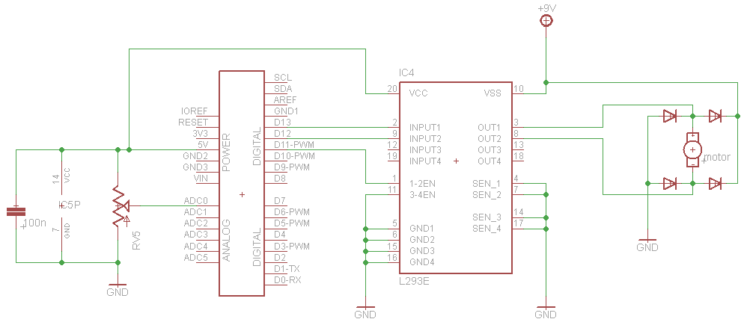
Analog Motor Control
Load AnalogL293Ctrl sketch

Slide 28
Analog Motor Control, explained
This is sign-magnitude control – PWM on D11 determines magnitude, relative values of D12 and D13 determine sign.
Setting D12 = D13 while D11 is HIGH produces a braking effect, since the motor becomes a generator with shorted terminals.
Inductive kick absorbed by the diodes
There are lots of H-bridge driver chips on the market in all sorts of different configurations.

Slide 29
Reasons to Roll Your Own H-bridge
If existing driver chips are…
Too little current
Too low maximum voltage
Wrong features
Too slow
Or you want to learn how they’re put together

Slide 30
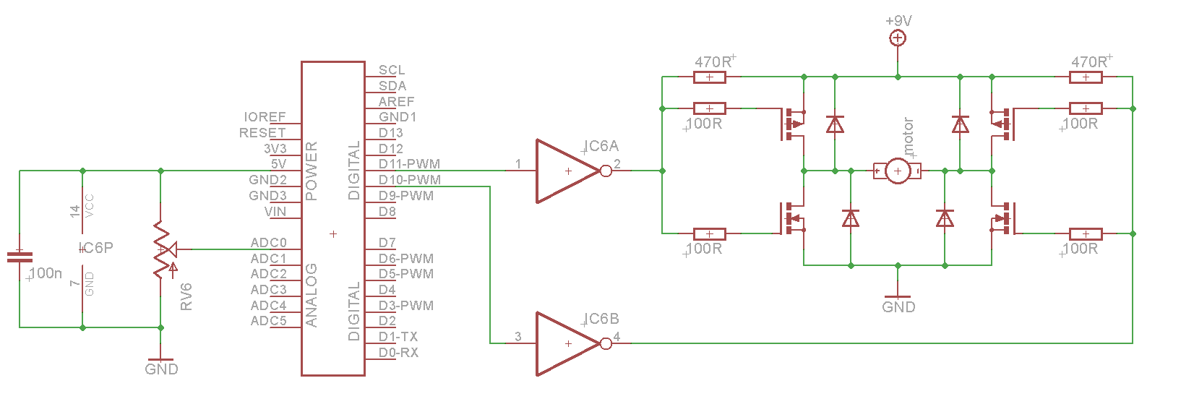
An H-bridge Circuit
Load AnalogHBridgeCtrl sketch

Slide 31
Things to do with H-bridges and half bridges
Replacing the motor with a speaker or similar load creates a Class D amplifier
Two H-bridges drive a bipolar stepper motor
Driving the primary of a transformer with an H-bridge can generate an AC waveform of any voltage and frequency.
Three half-bridges drive a brushless DC motor

Slide 32
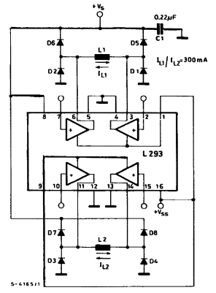
Bipolar Stepper Connection

Slide 33
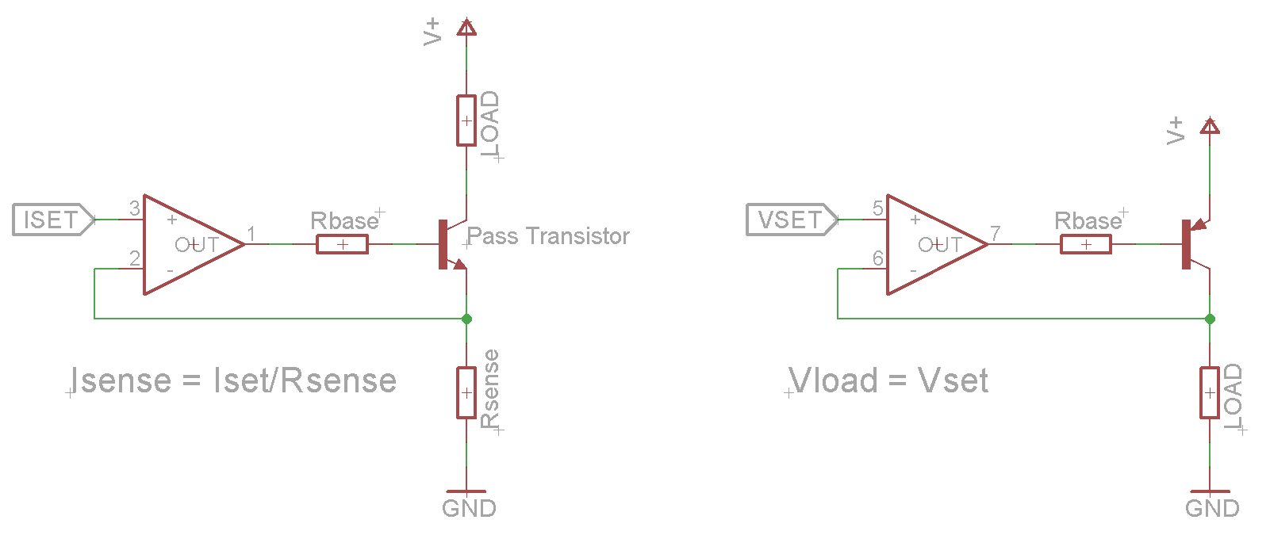
Other Power Transistor Tricks
Use an op-amp to drive the base of a NPN or PNP pass transistor to produce a constant current or constant voltage.
Use a series inductor and feedback through a microcontroller to set a programmable voltage or current.

Slide 34
Useful References
International Rectifier

